Slide 1
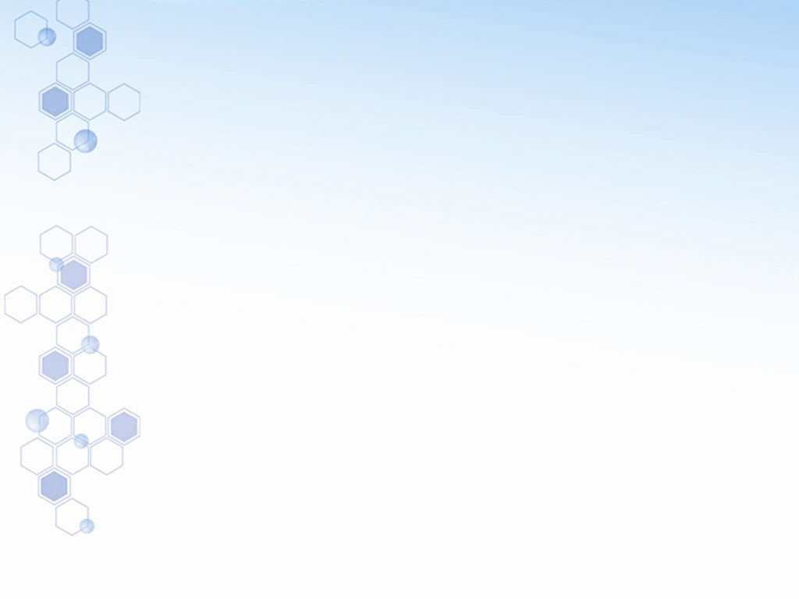


Notes:
You can change your life with ASEA!

Slide 2
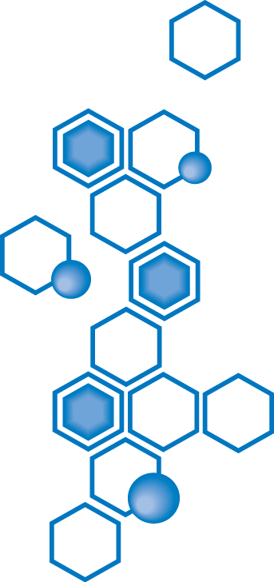
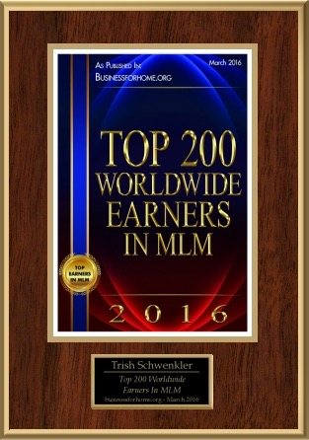
Ovat maailmanlaajuisesti 200:n parhaiten ansaitsevan joukossa

Slide 3
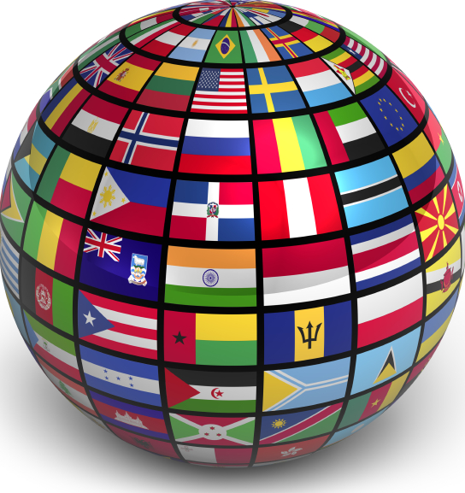

  Tuotteet
  Patentit
  Tarkoitus
  Ihmiset
Notes:
ASEA is a global company based on a fast-growing field of science called “Redox Signaling”.
We believe that the pathway to health lies in the body’s profound ability to heal itself.
Our company’s scientific breakthrough is positioned to affect almost all areas of health and personal well-being.

Slide 4

ASEAn missio:
Parannamme ihmisten elämää ja edistämme hyviä asioita maailmassa.
Toimii 26. maassa ja laajenee
Pohjois-Amerikka, Eurooppa, Australia/Uusi Seelanti
$320 miljoonan kumulatiivinen myyntivolyymi
Perustettu 2010, velaton, kannattava alusta lähtien
Notes:
ASEA’s Mission is to better people’s lives and to be a force for good in the world.
Launched in 2010 with just ONE product, ASEA has expanded to over 25 countries ­ with total sales of $320 million by 2016.
Since this was all done through word of mouth, it’s a good testament to the effectiveness of the product and it’s unique nature, don’t you think?

Slide 5


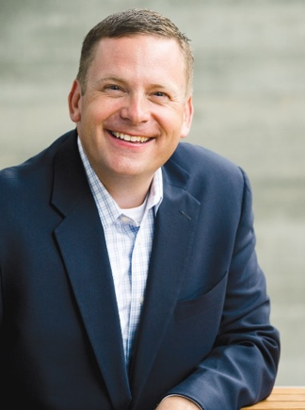
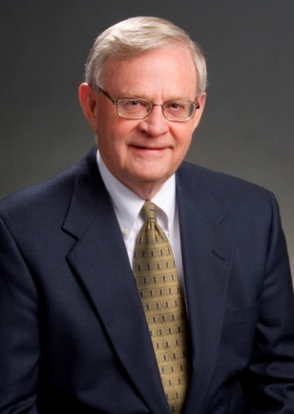
ASEAn perustajat kieltäytyivät lääkeyhtiön antamasta tarjouksesta
Verdis Norton
Tyler Norton
Notes:
ASEA was founded by some businessmen who came upon a unique technology while it was still in research and development. What began as a business venture became a purpose-filled mission to improve lives.
When a major pharmaceutical company wanted to buy the patents, these businessmen refused, even though they were offered an amount that would have guaranteed generational wealth.
Their goal became one of bringing this breakthrough directly to the people, by the people - as quickly as possible. In doing so, they put “principles and purpose” over “ego and economics”.

Slide 6
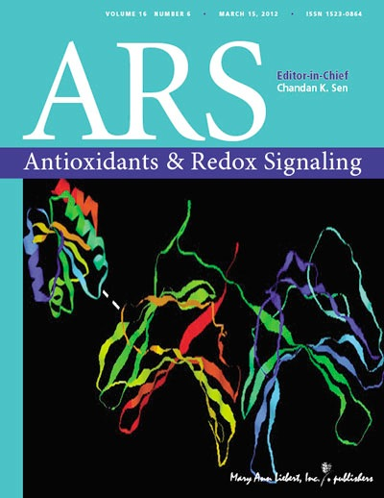
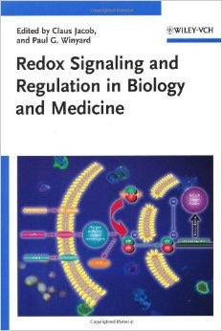
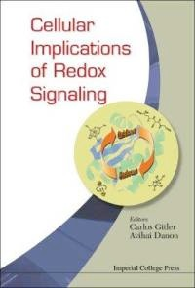
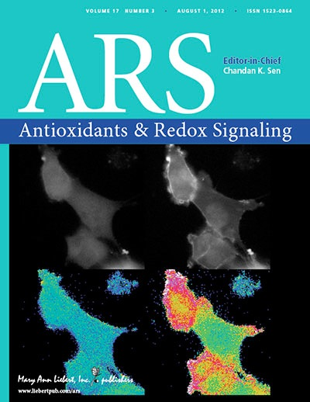
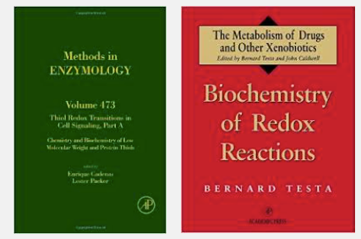
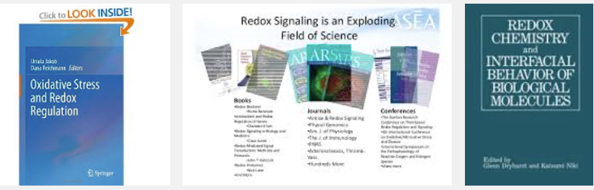
Redox Biokemia:
Yksi maailman nopeimmin kasvavista tieteellisen tutkimuksen aloista
Redox Biokemiasta on julkaistu yli 1200 kirjaa
Redox viestinnästä on julkaistu yli 10.000 vertaisarvioitua artikkelia tieteellisissä ja lääketieteellisissä aikakauslehdissä!
Notes:
ASEA’s technology is based on “Redox Biochemistry”.
Over 10,000 studies on “Redox Signaling” have been published in scientific and medical journals.
Although you may not have heard of it, over twelve hundred books have been published on the subject.
Multiple Nobel prizes have been awarded in the field of Redox Signaling

Slide 7

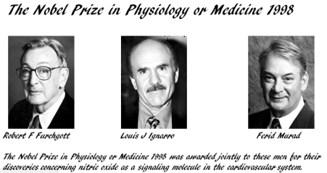
RSM Nobel-palkinto
(RSM = Redox viestintämolekyylit)
Fysiologian tai lääketieteen Nobel-palkinto
Notes:
Multiple Noble prizes have been given in the field of Redox Signaling Molecules

Slide 8


Mitä Redox viestintämolekyylit ovat?
Redox
viestintämolekyylit
Toimivat solujen viestinviejinä ja kehittyvät kehomme jokaisessa solussa. Ovat elintärkeitä.
Pelkistimet (RS):
auttavat estämään solujen vahingoittumista (vanhenemista) ja suojaavat tauteja vastaan.
Oksidantit (ROS):
tukevat kehon omaa immuunijärjestelmää.
taistelevat viruksia ja bakteereita vastaan
Energia
Solu (suolavesi)
Redox viestintämolekyylit
}
Notes:
What are Redox Signaling Molecules?
Every one of your 75 trillion cells are made of salt and water.
Every one of your trillions of cells are constantly producing energy.
This is the secret and the essence of life!
In the process of producing energy, your own cells create “Redox Signaling Molecules”.
Redox comes from 2 words:
Reductants: carry messages that tell your cells to activate antioxidants. Anti-oxidants are “anti-rusting” molecules.
Oxidants: enable proper cell communication to ensure optimal performance of the immune system
These important molecules control every biochemical and electrochemical reaction that takes place within your body.

Slide 9
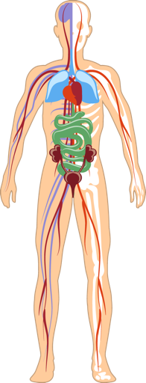
Miksi me tarvitsemme
Redox viestintämolekyylejä
Redox viestintämolekyylit säätelevät kehomme 12 pääjärjestelmää:
immuuni, hermosto, umpieritys, ruuansulatus jne.
valvovat jokaista biokemiallista ja sähkökemiallista reaktiota elimistössä
Redox viestintämolekyylit ovat elintärkeitä:
aktivoivat antioksidantteja
solujen väliselle viestinnälle
tehostavat kehosi luonnollisia uudistumisprosesseja
antavat tehokasta apua ikääntymistä vastaan
“Tällä teknologialla on mahdollisuus edistää terveyttämme enemmän kuin koskaan aiemmin on ollut mahdollista.”
-Dr. Gary Samuelson, Ph.D Author of “The Science of Healing Revealed"
Notes:
Redox signaling molecules are the foundation of healthy cells. Redox molecules are critical to every major body system and function.

Slide 10

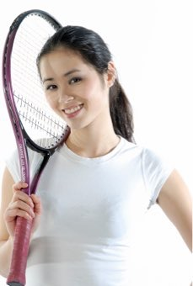
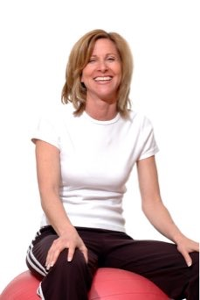
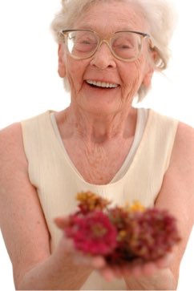
Iän, ruokavalion ja stressin myötä
solujemme aktiivisuus vähenee
Redox tuotanto vähenee ja keho joutuu epätasapainoon
Notes:
We produce fewer and fewer of these molecules as we age. Since Redox Signaling Molecules send out signals, when there is a problem, not having enough of them is like our cells making 911 calls without a good signal. As a result, we tend to have more chronic health problems than we had when we were younger.
Our eyes weaken, our memory isn’t what it used to be, our joints begin to hurt. Our immune system feels weaker - or too reactive. Our intelligent body seems to be losing some of it’s intelligence.
Many people assume these issues are inevitable or just a part of aging. But researchers now understand that many are the result of deficiencies and imbalances in REDOX function.

Slide 11
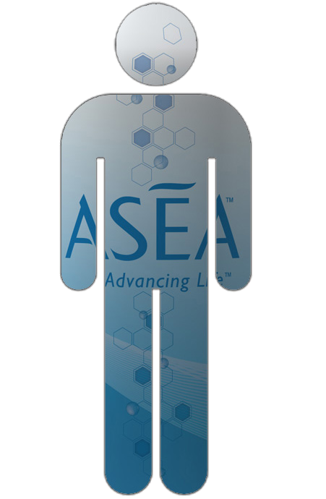
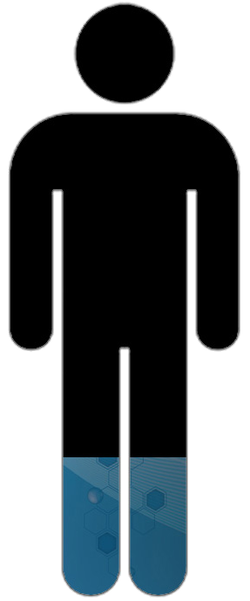
Notes:
We all look kind of like this guy. Our supply of redox signaling molecules is depleted and imbalanced. What if there was a way to replenish these important redox signaling molecules so that we could start to look and feel the way we did 5-10-15 -20 years ago??

Slide 12
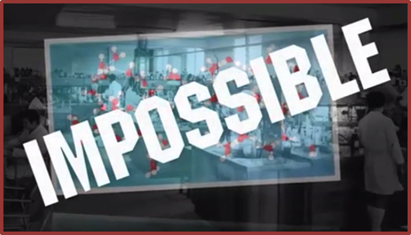
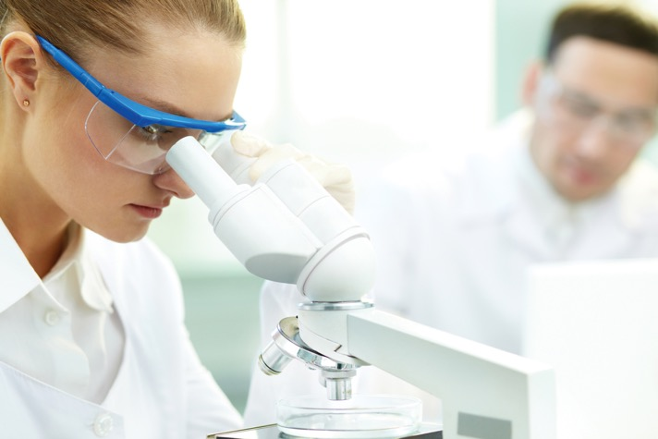
REDOX LÄPIMURTO
Laajojen tutkimusten ja laboratoriotestien, sekä miljoonien käytettyjen dollareiden jälkeen ryhmä tiedemiehiä onnistui saavuttamaan “mahdottoman”.
He kehittivät ja stabiloivat Redox viestintämolekyylit kehon ulkopuolella täydelliseen tasapainoon, aivan samalla tavalla kuten ne esiintyvät terveissä soluissa.
Notes:
Building upon decades of research, investing millions, and working with an Atomic Medical physicist, ASEA created the First and only source of redox molecules stabilized outside of the body.
They are bioactive and ready to get to work!
With this heavily patented technology, ASEA has created safe products providing astounding health and anti­-aging benefits.

Slide 13
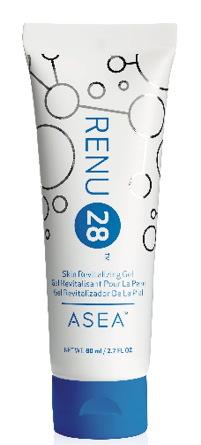
Ainoastaan yksi yritys on pystynyt valjastamaan Redox molekyylien voiman
Notes:
One company has been able to harness the power of redox signaling molecules.

Slide 14
Notes:
Welcome to this ASEA presentation. Thanks for making time to be here.

Slide 15
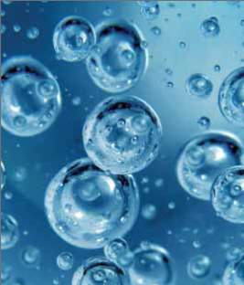

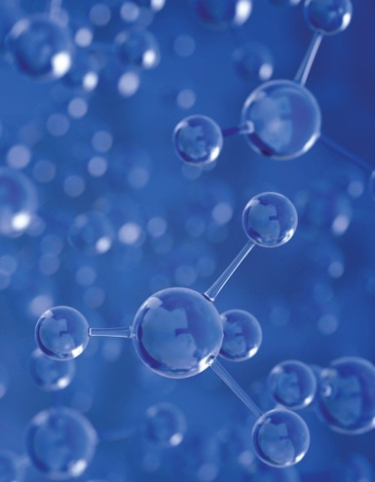
ASEAn patentoitu 3-vaiheinen prosessi
Vaihe 1
Puhdasta suolavettä
(samaa kuin soluissa)
Vaihe 2
Suolavesi hajoitetaan vapaasti kelluviksi atomeiksi
(NA-Cl-H-O)
Vaihe 3
Atomit järjestetään uudelleen
tasapainoisiksi Redox- viestintämolekyyleiksi
Notes:
ASEA starts with 2 simple ingredients: Water and Salt. Why? When our own cells make Redox Molecules, they use resources they have in abundance: water and salt. Using heavily patented technology, ASEA replicates the body’s natural process.
The water and salt molecules are broken into free floating atoms, and restructured into a perfectly balanced mixture of Redox Signaling Molecules.
After this process is complete, only a little salt remains. One serving of ASEA contains only about as much sodium as a carrot.
Even those on a salt restricted diet can usually find room to include ASEA.

Slide 16
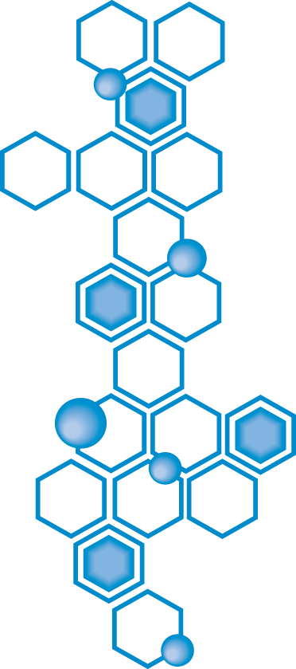
Valmistettu
“suolasta ja vedestä”,
aivan kuten soluissammekin.
Notes:
This is the quiz I promised earlier. Why does ASEA start with salt and water? Answer: these are the same basic ingredients our cells use to make redox molecules.

Slide 17
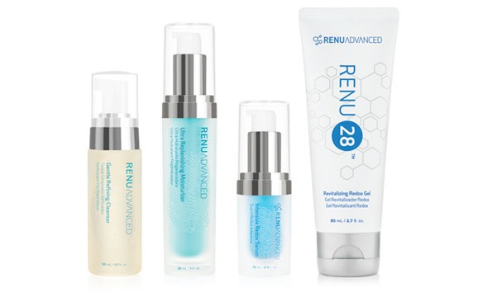
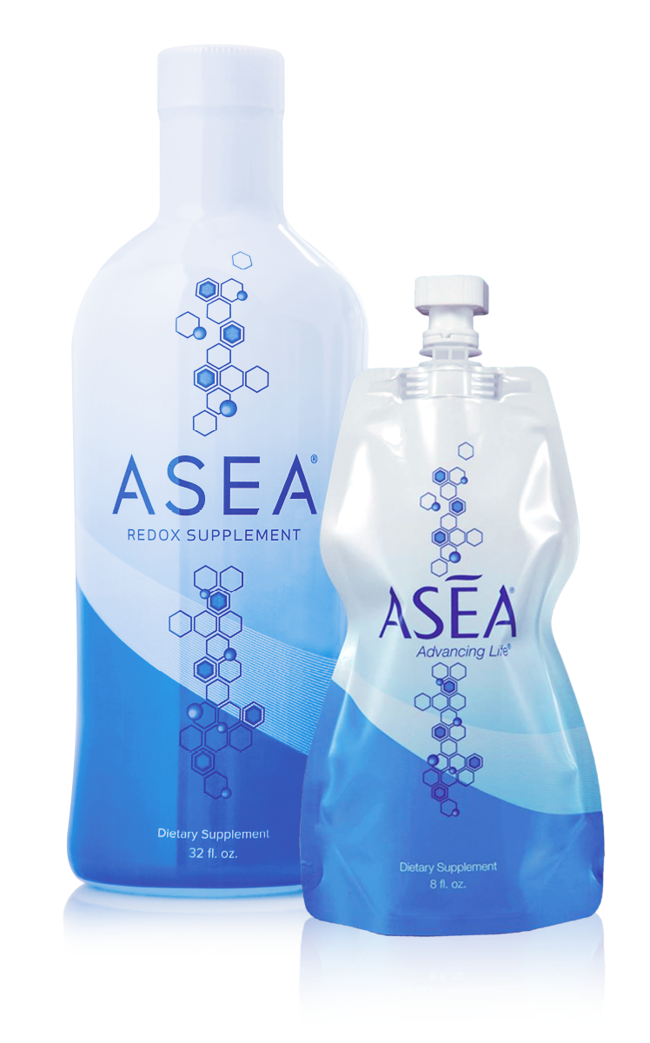
Redox molekyylit
sisältäpäin
ulos
ulkoapäin
sisään
Notes:
ASEA offers products that enhance cellular health from the inside ­out ­ and from the outside ­in.
ASEA Redox Supplement is the company's flagship liquid supplement.
RENU 28 is a more concentrated form of ASEA. It’s a full body revitalizing gel that can be applied anywhere you would like to look or feel better.
To enhance the anti­-aging benefits of RENU 28, ASEA has created the world’s only redox based skin care line called Renu Advanced.

Slide 18
ASEAn läpimurto
17 vuotta tutkimustyötä, miljoonia dollareita, moninkertaiset kansainväliset patentit
Redox viestintämolekyylit
Auttavat solutason palautumista
Kehon omia aineita
Ei sisällä kiellettyjä aineita
100-prosenttisen turvallinen
Sisältää vain vähän natriumia
Notes:
-There is 17 years of foundational research behind this process. Multiple US and international patents,. Redox Signaling molecules empower your 75 trillion cells to restore themselves so they can function the way they did when you were younger
-The molecules in ASEA are the exact same identical molecules that are made inside of your cells, they are native to the body.
(If you could un-zip one of your cells, squeeze it in a glass , and drink it, that would be the essence of what ASEA is!!)
-Since they are the same molecules your body creates, they don’t contain any banned substances.
-100% safe: it is safer to drink in any amount. safer than bottled water
-ASEA is made from salt and water,but when the whole process is finished, there is almost no sodium in ASEA . 1 serving of ASEA contains about as much sodium as a carrot, and most people on low sodium diets don't worry about eating a carrot!

Slide 19
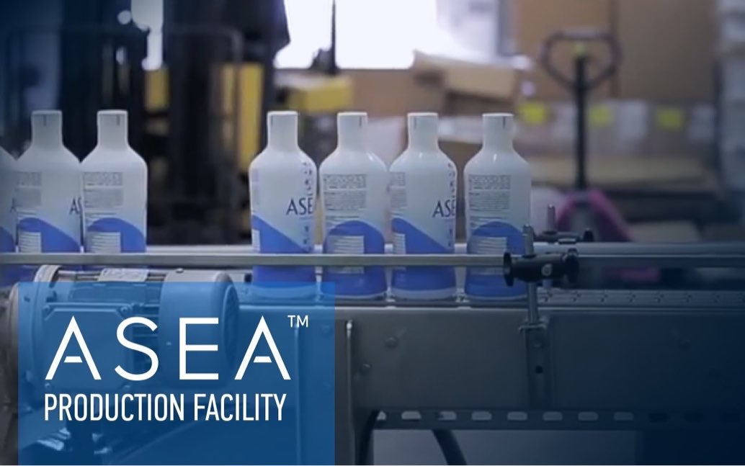
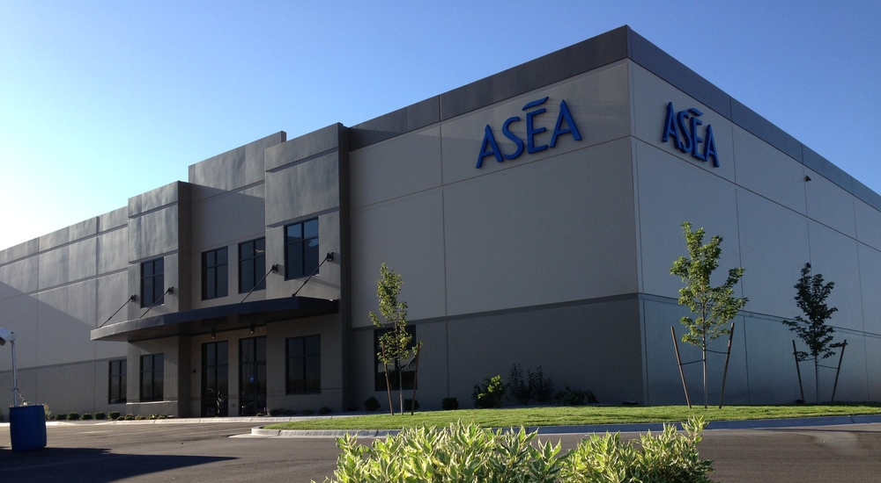
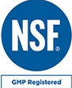

NSF sertifioitu, GMP
FDA rekisteröity, Kosher
ASEAn oma tuotantolaitos
Pleasant Grove UT USA
Notes:
ASEA’s one-of-a-kind, in-house manufacturing plant it located in Pleasant Grove UT. This is the only place in the world where balanced, stabilized redox signaling molecules are manufactured .

Slide 20
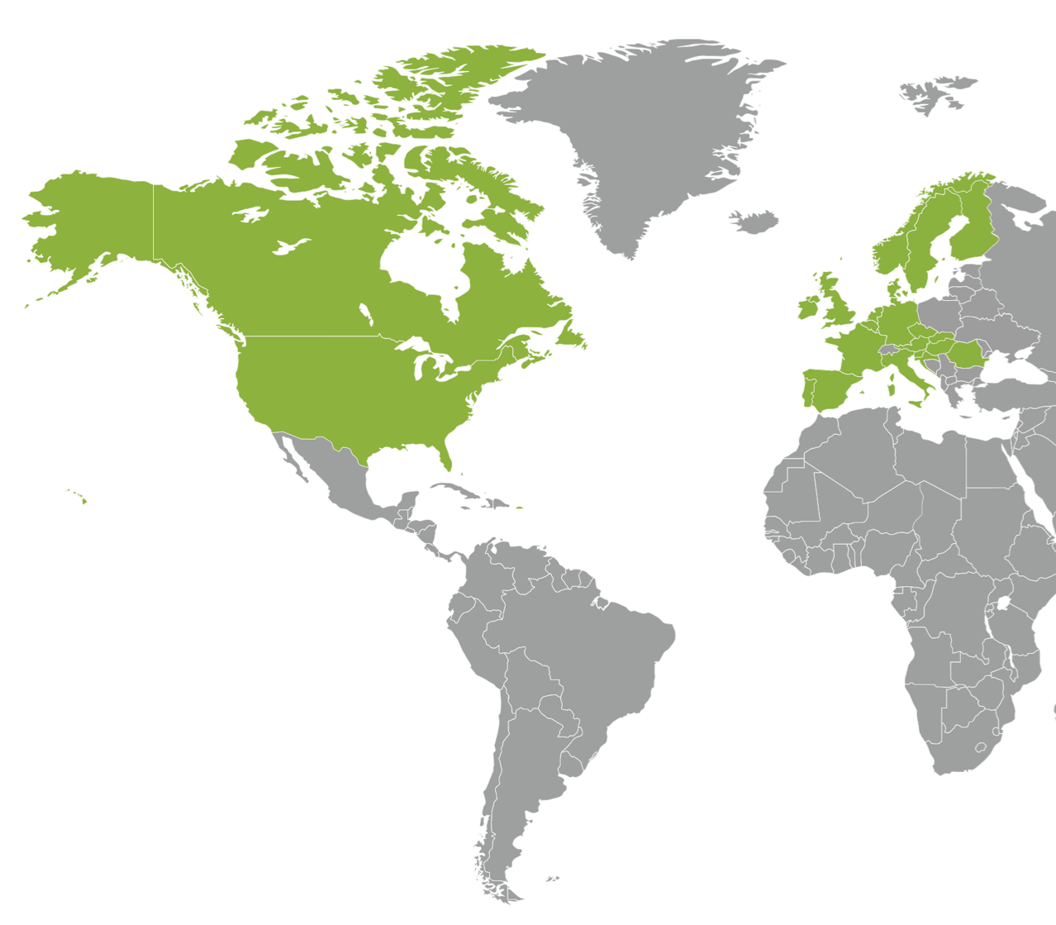

ASEA-tuotteiden jakelujärjestelmä
12 Globaalia toimitus- ja jakelukeskusta
Notes:
Then ASEA ships the product by boat to 12 distribution centers around the world.

Slide 21
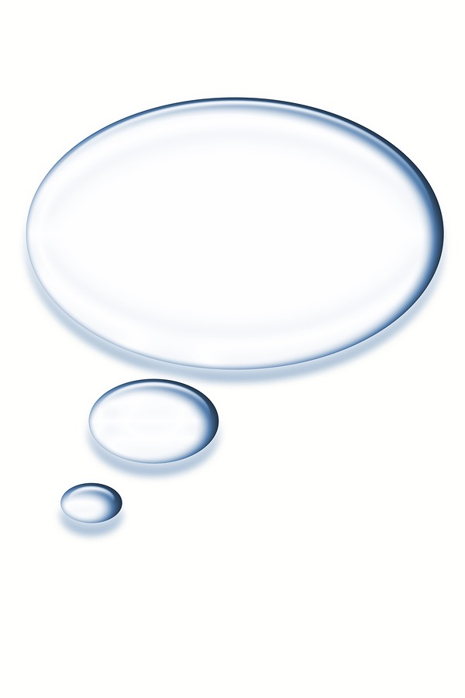


Totta vai tarua?
Notes:
The positive information on ASEA and the Redox technology abounds on the web BUT keep in mind that google is a search engine, not a research engine! When you “google” ASEA, you might see a site come up that says ASEA is just expensive salt water.
This blog was written in 2012 and didn’t acknowledge all the testing that ASEA had done at that time and since 2012 there are many new clinical studies done by ASEA that the site doesn’t acknowledge. It offers no field test results, no lab results, no clinical trial results, and no evidence of ANY KIND. Their claims are backed solely by a non-practicing physician who retired from the industry 27 years ago…
Would YOU trust a website that hasn't been updated in 4 years and doesn’t present accurate information?
Or a doctor who hasn't practiced in 27 years?
You be the judge.

Slide 22
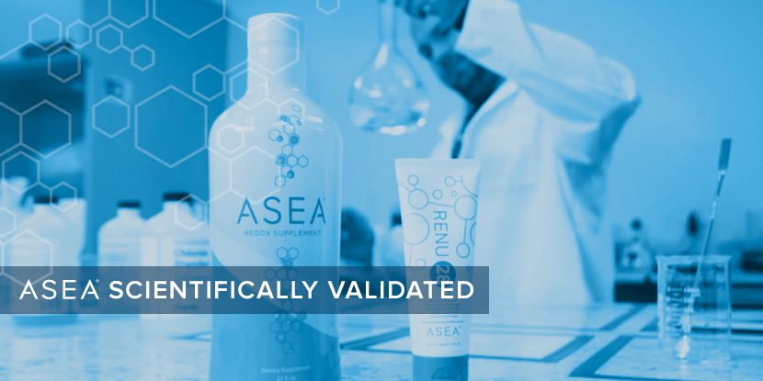


TIETEELLISESTI TODISTETTU
REDOX SERTIFIOITU
Notes:
Please understand that many reputable 3rd parties have endorsed ASEA.
To verify the presence of bio-active redox signaling molecules in our “redox certified” products , ASEA uses in-house testing, as well as the services of an independent Lab that performs bio­-analysis for 21 of the top 25 global pharma and biotech companies.
ASEA also partners with several world­ class independent labs for clinical testing.
Before I talk about results of those clinical tests I’d like to introduce you to our product line.

Slide 23
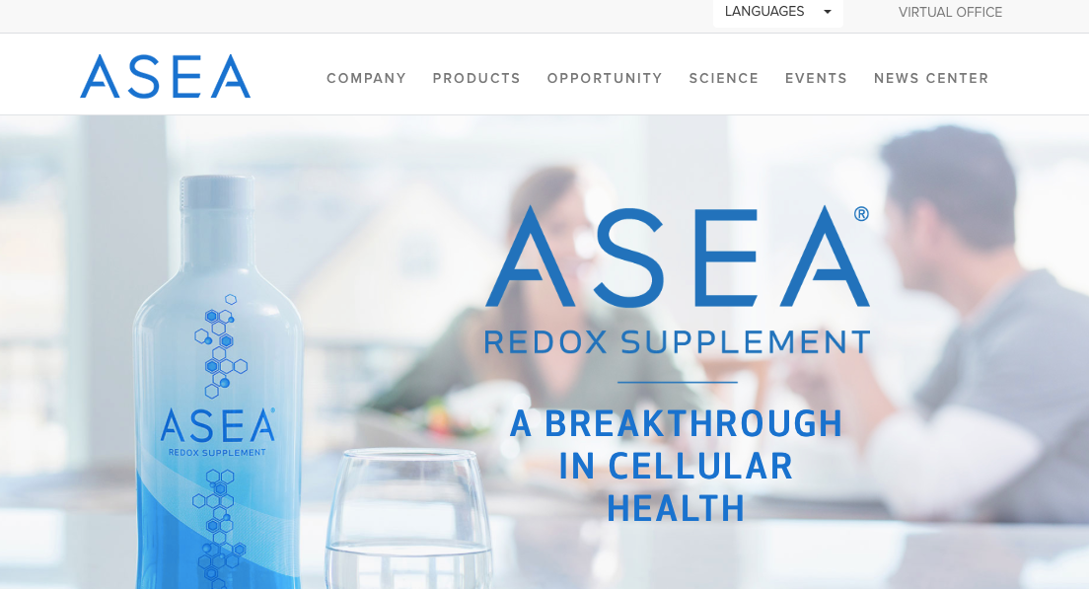
www.ASEAGlobal.com
Notes:
www.aseaglobal.com is the ASEA corporate website where you can find valid information, especially under the science tab

Slide 24




Maailmanluokan kliinisten kokeitten ja tutkimusten laitoksia
Notes:
ASEA partners with 3rd party independent laboratories for clinical trials and testing:
-Stephens and Associates, Inc. ensures the successful testing of pharmaceutical, devices, cosmetics, and personal care products for safety, efficacy, and substantiation of product performance claims in clinical research Texas, Colorado, Japan
-Dermatest: One of the top 5 dermatological testing companies in the world germany
-BioAgilytix Research Triangle NC
scientific experts enabling scientific innovators to successfully develop, prove, and deliver life-saving, game-changing large molecule therapeutics.
-N Carolina Human Performance Lab leader in nutrition and exercise immunology. exercise-induced changes in immune function, oxidative stress, and inflammation.

Slide 25
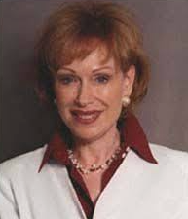

Ann Louise Gittleman
Yksi maailman johtavista funktionaalisen ja ravitsemuksellisen lääketieteen asiantuntijoista
New York Timesin mukaan yksi parhaiten myyvistä kirjailijoista, joka on kirjoittanut yli 30 kirjaa terveydestä ja ravinnosta
“Etsin jatkuvasti luonnonmukaisia tuotteita, jotka voivat korjata geneettisen perimäsi. Yksi tuote on ylitse muiden: ASEA.
Yksinkertaisesti sanottuna, ASEA viestittää soluillesi, että pysykää terveinä.”
\

Slide 26
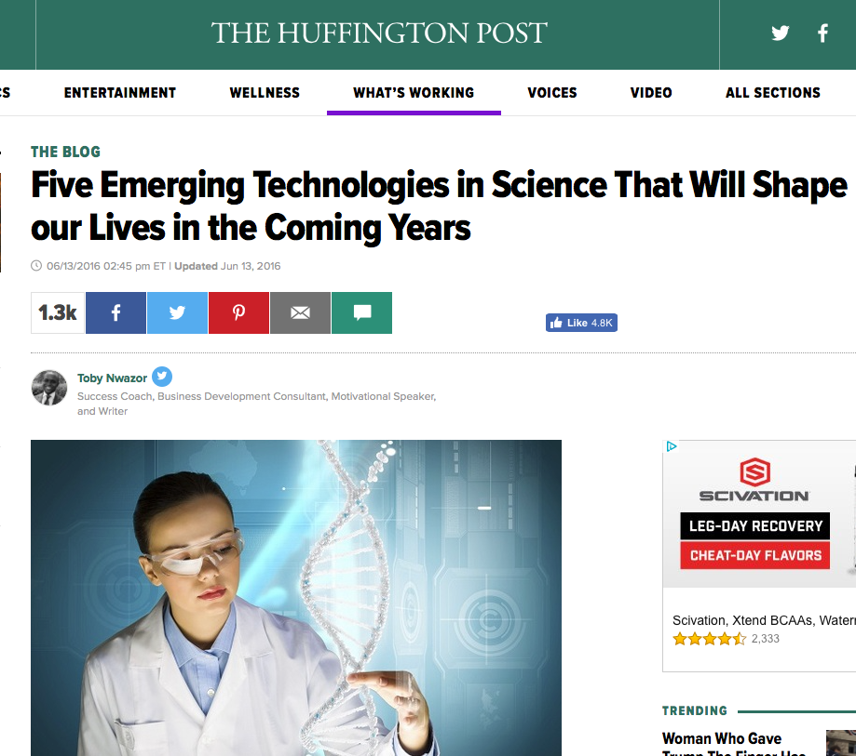
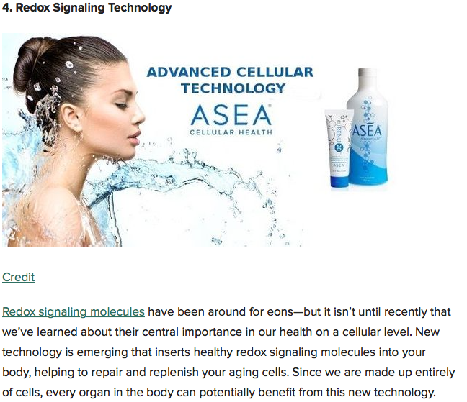
Huffington Post
Redox viestintäteknologia

Slide 27


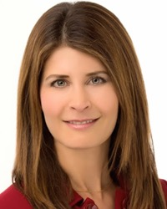
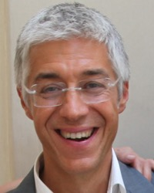
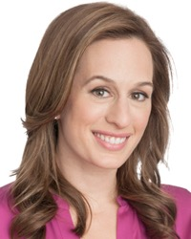
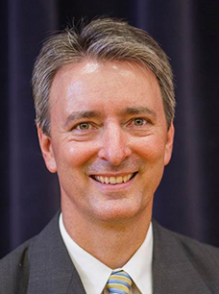

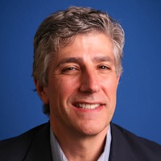
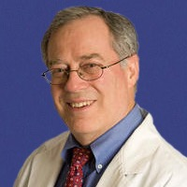
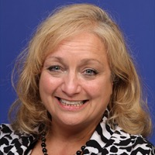
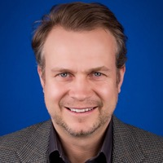
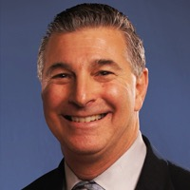
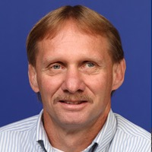
ASEAn Tiedeneuvosto
Karen R. Stolman, M.D
Dr. Giuseppe Maffi
Brooke Alpert, M.S., R.D., C.D.N.
Dr. Richard Watt, Ph.D.
ASEAn lääketieteen ammattilaisten johtokunta
Dr. David Silverman, D.P.M.
Dr. Stan Gardner, M.D.
Dr. Maureen Hayes, M.D.
Dr. Karl V. Smith, D.C.
Dr. Foster Malmed, D.C., P.C.
Shawn Burke, P.T.A, CPT
Notes:
Many doctors, scientists, athletes and well-known experts in various fields endorse ASEA, and they are rapidly growing in number.
Many are engaged in very distinguished careers and have very impressive credentials. They have done their research. Many volunteer their time on ASEA’s behalf.
ASEA’s position as a category-creator has gained worldwide attention.
ASEA is respected for it’s dedication to “principles and purpose” over “ego and economics”, the core ethos of our company.
It attracts great minds, big hearts, and spiritually-minded people who believe they have a responsibility to share this gift with humanity.

Slide 28
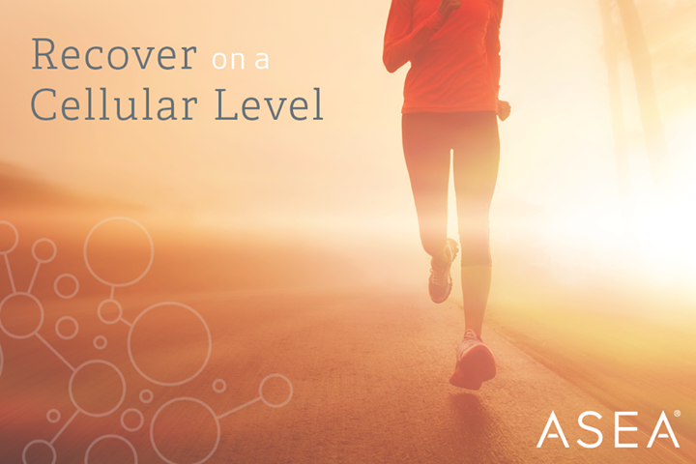


Kuka voi hyötyä Redox teknologiasta?
Urheilu & Urheilijat
Terveys & Hyvinvointi
Kauneus & Ihonhoito
Notes:
Who can benefit from ASEA’s technology?
Everyone cares about having good health.
Athletes benefit from faster recovery and more endurance.
Most of us enjoy looking better.
ASEA has created something that no one else in the world has! Something that can benefit everyone.

Slide 29
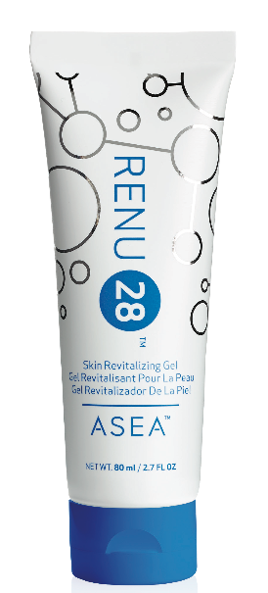
Ihoa syvemmälle
Käytä Redox molekyylejä
“3 kertaa 5:ssä minuutissa”
Tunnista kehon alue, jossa on epämukavuutta, arkuutta, stressiä, kireyttä tai rajoittunut liikerata
Arvioi se asteikolla 1-10 (10 on huono)
Levitä Redox geeliä 3 kertaa 5:n minuutin sisällä
Arvioi uudelleen epämukavuus, arkuus, stressi, kireys tai rajoittunut liikerata asteikolla 1-10
Koe, mitä tapahtuu!
Notes:
Invite the guests at your meeting to experience Redox Molecules by using the “3 in 5” method from Dr David Silverman

Slide 30
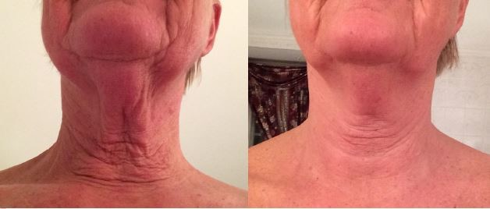



Koko kehon elvyttävä
Redox geeli paikalliseen käyttöön
Notes:
Invite the guests at your meeting to experience Redox Molecules by using the “3 in 5” method from Dr David Silverman

Slide 31

Redox geeli
Soluterveyttä ulkoapäin sisään
Redox Signaling Molecules in a Gel
Supports the foundation of your skins cellular structure
Unlike any other skin care - This Changes Everything!
Clinically Tested, Amazing Results!
Notes:
This picture demonstrates the power of redox molecules to empower the body to heal itself. This woman used Redox Gel for 28 days, Look at the before and after picture. First look at her chin. Then look at the texture or her skin. Finally, look at the skin inside the red box. In this picture you can see the results of apoptosis. Redox Molecules send signals that tell our body to destroy unwanted cells . This is called Apoptosis. Then the neighboring healthy cells divide and take their place, resulting in healthy tissue.
Isn’t this what we want to happen to the tissues on the outside as well as the inside of our body?
(ASEA recently announced that findings of researchers at the University of Vermont College of Medicine show that Redox Signaling molecules are crucial in the regulation of apoptosis. https://healthylivingresources.wordpress.com/2012/04/19/969/)

Slide 32



RENU ADVANCED Redox ihonhoito
43% Iisääntynyt ihon kosteus
Notes:
Renu Advanced is the world’s FIRST and ONLY REDOX­ Signaling, ANTI­AGING skin care system! For men and women of all ages and skin types. We prepare our skin to receive redox signaling molecules by using the Gentle Refining Cleanser. It tones and hydrates skin while washing away dirt, oil, and impurities.
Then we apply RENU 28 Revitalizing gel to face, neck and anywhere we want to repair.
Intensive Redox Serum can then be applied to specific trouble areas, and results can often be seen within 30 minutes. Great for targeting under the eyes or around the mouth.
After waiting several minutes, we apply Ultra ­Replenishing Moisturizer. Clinical trials show that this high end product leaves skin 43% more hydrated within 4 weeks. The moisturizer pairs a topical probiotic with oxygen attractors, which increase the oxygen content of your skin.
Why is this important? by age 40, the oxygen content of skin is typically depleted by 50%.
ASEA’s RENU Advanced Skin Care line caused a reduction in photo-aging in 92% of 3rd-party clinical trial participants in 8 weeks! "Photo-aging" is the damage done to skin from sun exposure over a person's lifetime.

Slide 33


Redox molekyylit URHEILIJOILLE
Palautuminen,kestävyys,sitkeys
Notes:
Please raise your hand if you are an athlete. Congratulations to those who raised their hands. If you did not raise your hand, let me ask you a question: in your daily life, do you need endurance, strength, recovery, and stamina??
Of course, we all do! Everyone from the fittest of the fit to the sickest of the sick and everyone in between, everyone can benefit from the Amazing Molecules of ASEA!

Slide 34






ASEAN URHEILIJAT
Notes:
http://www.athleteedge.com/

Slide 35

Muuttaa ihmisten elämää kaikkialla maailmassa
Notes:
Thousands of testimonials have come in from people receiving profound benefits from our products.
Some people notice positive changes very quickly.
For others in can take several months.
Studies show that virtually eveyone can benefit from ASEA’s products whether they notice a difference or not.
(If this is a group, ask if anyone would like to share a one-minute testimonial of their own experiences. If it is just you who is able to share, share your own one-minute testimonial. You can also listen to a testimony from the daily conference call, or play the testimonial video on the next slide)

Slide 36


ASEAA & RENU 28:aa ei ole tarkoitettu käytettäväksi
minkään sairauden diagnosointiin, hoitamiseen, parantamiseen tai ehkäisemiseen.
Notes:
ASEA makes no medical claims to prevent, treat or cure any disease or health condition. In the U.S., only a substance classified as a pharmaceutical drug can makes those claims. ASEA is classified as a dietary supplement. It is a molecular supplement that supports the body’s own innate ability to heal itself.

Slide 37
ASETA ODOTUKSESI OIKEIN
90%+
75-85%
50-65%
10-15%*
Riippumattomissa aineenvaihduntatutkimuksissa näkyy välittömästi myönteisiä vaikutuksia.
Riippumattomat tutkimukset todistavat sairauksien riskitekijöiden vähentyvän.
Havaittavissa olevat vaikutukset vaihtelevat eri henkilöitten välillä.
Notes:
It is important to know that everyone is different, and just like everything else, people respond differently to ASEA products, so let’s set some correct expectations. These results are based on the ASEA Redox Supplement and the experience over 5 years of using it in the US.
• In 1 week, approximately 10% of people notice something change– that means 90% of people don’t think it works.
• In 1 month, about 50% of people notice positive changes
• But in 90-120 days, approximately 90+% people notice a positive result.
That is why we always recommend you give the products a 90-120 day trial, and you just might be amazed at the results you see and feel for yourself.
With Renu 28 people can often experience benefits quickly. However, we are all unique so we always recommend using it regularly for 90-120 days , and again, be sure to take pictures before you start!

Slide 38




Valmistaja
Tele-
markki-
nointi
Paperi-
lehdet
Postitus
TV &
Radio
Asiakkaat
Asiakassuhdemarkkinointi
Notes:
ASEA manufactures the product. Their goal is to get it to customers. Instead of spending money on traditional forms of advertising, ASEA depends on us to share with others. Word of mouth is still the most powerful form of advertising. who heard about ASEA from someone you have a relationship with? a relative, a friend, a co-worker? (almost everyone raises their hand)

Slide 39

MIKÄ MARKKINOINTIKANAVA TEHOAA UUSIIN ASIAKKAISIIN?
25
20
15
10
5
0
Julisteet
Radio
TV
Sähköposti
Kännykkä
Verkkokaupat
Sanomalehdet
Sanallinen viestintä
Paikallishakemistot
Paikallishakemistot
Mainoskampanjat
Hakukonemainonta
50%
globaalista volyymistä
maksetaan kumppaneille
Notes:
As more and more people are learning about ASEA’s breakthrough and realizing it’s potential for helping so many
our company rapidly rose into the Top 100 direct selling companies worldwide. There are thousands of direct selling companies, so this is quite remarkable for such a young company with a small number of products.
Offering ASEA through Network Marketing allows everyday people like me and others who share our vision to benefit financially, rather than advertising agencies or pharmaceutical companies,
ASEA is more available to more people for a broader range of health concerns - than it would be if it had become a drug.
Our products require explanation. Network Marketing rewards people who invest their time, credibility and influence to tell their company’s story.
ASEA gives 50% of global volume back to people like us as thank you checks, every single week.
Residual income is money that continues to be generated whether you are working or not. For example, interest on money you have in the bank is out of reach for most people. When Network Marketers find their team of distributors and customers growing, residual income can become a reality for them

Slide 40

Ansaitse ”kiitos rahaa”
muuttamalla
ihmisten
elämää
ympäri
maailmaa
Notes:
Do you see how powerful and unique this technology is? No one in the world except ASEA produces Redox Signaling Molecules outside of the body.How would you like to earn “Thank you” checks by changing people’s lives? who have you thought of that can benefit from Redox Signaling Molecules?

Slide 41
tapaa ansaita rahaa ASEAn kanssa
8
Diamond
Pool
Executive Momentum Pool
Check
Match
Team
Commi-
ssions
Director Bonus
Preferred
Customers
Fast
Start
Retail
RAJATTOMAT TULOT: kehittyvät ajan myöta. Perustuvat tiimisi aktiivisuuteen
VÄLITTÖMÄT TULOT: suorat tulot. Perustuvat henkilökohtaiseen aktiivisuuteesi

Slide 42

“Ansaitsen mielummin 1% 100 ihmisen ponnisteluista kuin 100% omista ponnisteluistani”
You
one hour
1 h
+3 h
+9 h
+27 h
40 h pv
Jack
one hour
Jill
one hour
Joe
one hour
One
One
One
One
One
One
One
One
One
One
One
One
One
One
One
One
One
One
One
One
One
One
One
One
One
One
One
One
One
One
One
One
One
One
One
One
Rakenna TIIMIÄ!
Notes:
The way to maximize your earnings with ASEA is to build a big team of people who are using and sharing ASEA. Most people earn income from a 40 hour week. With ASEA , you can earn income equivalent to a 40 hour, and beyond, by building a team.

Slide 43











ASEAn palkkiojärjestelmä
Palkkioita maksettu 100 milj. USD
yli 35.000 kumppanille (vuonna 2015)
RAKENNUSMIES
KODIN SISUSTAJA
ARTISTI
LÄÄKÄRI
TALOUDELLINEN NEUVONANTAJA
TARJOILIJA
KEHONRAKENTAJA
VASTAANOTTO-VIRKAILIJA
HIIHDON-OPETTAJA
YKSINHUOLTAJA-ÄITI
Generating meaningful compensation as an ASEA Associate requires considerable time, effort & commitment. There are no guarantees of financial success.
Notes:
ASEA Associates come from all walks of life, and ASEA has paid out over $100 million in commissions. Would you like to get a piece of that?

Slide 44

“Mikään ei ole sen parempaa kuin ansaita elantonsa tekemällä jotain merkityksellistä.”
Notes:
Our favorite saying is “There is nothing better than making a living while making a difference” , and that has never been more true than with ASEA!

Slide 45
Miksi ASEA? 6 syytä
Minulla on terveydellisiä haasteita tai haluan varmistaa, että pysyn terveenä myös tulevaisuudessa
Tunnen jonkun tai jollakin läheiselläni on terveydellisiä haasteita
Haluan parantaa energiatasoani, kestävyyttäni, urheilullista suorituskykyäni
Haluan nuorekkaamman, säteilevämmän, terveemmän ihon
Etsin lisätuloja / taloudellista vapautta
Haluan saada aikaan positiivisen muutoksen muiden ihmisten elämään
Notes:
People become interested in ASEA usually for one or more of these SIX reasons:
● They have a health problem, want to feel better, or they want to invest in future health
● They know or love someone with a health problem
● They are athletes or would just like to have more energy and less fatigue for daily life
● They want to improve the way they look and are attracted to the anti­-aging skin benefits
● They have financial stress They can use additional income and are attracted to the home
business opportunity
● They want to make a difference in the world and are attracted to being part of something visionary and pioneering, with like­ minded people

Slide 46



MISSÄ NÄET ITSESI?
1
2
3
Kuluttaja
Osa-aikainen rakentaja
$100–$1000
Täyspäiväinen rakentaja
$1,000 - $10k
ja enemmän
Notes:
Would you like to see the options people have with ASEA?
Where do you see yourself?
Some people would simply like to use our products and become valued “ ASEA Customers”. If this interests you, you can purchase at full retail price or receive discounted “Preferred Customer” pricing. Every day, all year long, and for as long as you take ASEA, your body will continue to have extra support for health and immunity. Aging and cell damage from the assaults of modern living will have less effect on you.
But your best deal is to join ASEA as an “ Associate”.
Here is why: Associates can get special pricing on their first order, and can qualify to receive free product and “thank­ you checks” from ASEA! It’s only $40 to join, and you receive a FREE, automated online business center. You also receive support from helpful people like me!
Business Builders are Associates who work at growing their ASEA business and help others do the same. We provide free training. Success can lead to growing residual income, time freedom and less stress about finances and retirement. Many achieve dreams they never thought would be realized.
Thank you so much for allowing me to share this information with you, and I would love to know what you think and whether any of the “Six Reasons” are yours.
(pass out signup/enrollment sheets, ask how the RENU 28 feels, answer questions)

Slide 47



Valitse itsellesi sopivin pakkaus
1
2
3
Notes:
Would you like to see the options people have with ASEA?
Where do you see yourself?
Some people would simply like to use our products and become valued “ ASEA Customers”. If this interests you, you can purchase at full retail price or receive discounted “Preferred Customer” pricing. Every day, all year long, and for as long as you take ASEA, your body will continue to have extra support for health and immunity. Aging and cell damage from the assaults of modern living will have less effect on you.
But your best deal is to join ASEA as an “ Associate”.
Here is why: Associates can get special pricing on their first order, and can qualify to receive free product and “thank­ you checks” from ASEA! It’s only $40 to join, and you receive a FREE, automated online business center. You also receive support from helpful people like me!
Business Builders are Associates who work at growing their ASEA business and help others do the same. We provide free training. Success can lead to growing residual income, time freedom and less stress about finances and retirement. Many achieve dreams they never thought would be realized.
Thank you so much for allowing me to share this information with you, and I would love to know what you think and whether any of the “Six Reasons” are yours.
(pass out signup/enrollment sheets, ask how the RENU 28 feels, answer questions)

Slide 48

ATeamSupport.com
Notes:
You can find these slides at www.ATeamSupport.com
Click on Presentations. Join ATeam weekly newsletter and FB group.
Success Training!
1, 2, 3, “Getting Started” Training plus 9 other training modules.

Slide 49

ASEA
muuttaa maailmaa solu kerrallaan
Notes:
ASEA is changing the world one cell at a time

